Slide 1

The Equity & Empathy Framework
An Educator's Toolkit to Combat Antisemitism and Hate
Joshua Goldenthal
Your Organization Name

Slide 2

The Why
The Problem: A Growing Landscape of Hate
Statistics show a concerning rise in antisemitism and other forms of hate.
The classroom is not immune; educators are on the front line.
Our professional and ethical obligations demand that we act.
Notes:
Good morning, everyone. Thank you for being here. We're going to start by addressing a difficult but crucial topic: the rise of antisemitism and hate in our communities and, by extension, our schools. Recent data from the 'Policy Recommendations' document you've been given highlights a significant increase in these incidents. This isn't just a societal problem; it's a professional one. As educators, we are on the front lines, and our response is critical. The professional advisory from the Ontario College of Teachers makes it clear: we have a professional and ethical mandate to create safe and inclusive spaces for all students. This toolkit is about empowering you to do just that.

Slide 3

Our Guiding Principle
Equity is Giving Everyone What They Need.
Empathy is Understanding Why They Need It.
Beyond compliance: This framework is a shift from simple 'rules' to a proactive, human-centered approach.
A holistic model for professional practice.
Notes:
This simple quote is the heart of our framework. It comes from the 'Equity and Empathy' guide. Too often, we focus on equity as a set of policies and procedures—which are important—but we miss the human element. The goal of this toolkit is to move beyond compliance and towards a practice that is rooted in empathy. It’s about not just giving a student what they need, but also understanding their unique story and why those needs exist.

Slide 4
Part 1: The Foundation - Your Professional Imperative
Your Mandate: The Professional Advisory
The Law: Your professional bodies (e.g., OCT) mandate that you create safe, equitable, and inclusive learning environments.
Your Role: You are not a neutral bystander. You are an agent of change, responsible for recognizing and responding to hate and discrimination.
Accountability: Your conduct, both in and out of the classroom, reflects on your profession and impacts the school community.
Notes:
The OCT's professional advisory is more than a recommendation; it's a clear directive. It states that our role is to protect students by fostering a sense of belonging. The advisory highlights that our conduct, even outside of school, is under scrutiny. This means we must be aware of how our actions and words, even online, can impact our students and the learning environment.

Slide 5
Part 2: The Framework - Reflecting & Responding
Step 1: Reflecting on Identity & Bias
Acknowledge Intersectionality: Students have multifaceted identities. Their experiences are complex.
Identify Your Own Biases: Unconscious biases are normal. The goal is not to eliminate them, but to recognize and manage them.
Intention vs. Impact: Your intention may be good, but the impact of your actions is what truly matters.
Notes:
Before we can effectively teach and lead, we have to look inward. The 'Equity and Empathy' guide emphasizes this with a focus on self-reflection. We all have biases; they're a natural part of being human. Our work is to become aware of them so we can mitigate their impact on our students. A key part of this is understanding that a student's identity isn't a single trait. A student might be Jewish, but also Black, and also a newcomer. Their experience with discrimination is unique and complex because of this intersection of identities.

Slide 6
Step 2: Responding to Hate & Discrimination
The 3 R's: Recognize, Report, Respond
Recognize: Learn to identify hate, including microaggressions, stereotypes, and overt acts. The FSWC toolkit offers specific examples.
Report: Always follow your school’s established protocols for reporting. This is a non-negotiable professional obligation.
Respond: The response should be immediate. Use the 'See, Feel, Act' model to interrupt harm and support those impacted.
Notes:
This is the core of our reactive work. When an incident of hate occurs, we must have a plan. The first step is to recognize it for what it is. The FSWC resource provides age-appropriate examples of antisemitism and hate, from biased language to more overt acts. Second, we must report it. This is not optional—it's part of your professional duty. Finally, we must respond. The 'See, Feel, Act' model from the 'Equity and Empathy' guide is a simple but powerful tool. See the behavior, Feel the impact by taking a moment to empathize with the victim, and Act to intervene immediately, restore a sense of safety, and address the harm.

Slide 7
Step 3: Building a Culture of Belonging
Proactive Action: Prevention is Key
Inclusive Curriculum: Integrate diverse stories and histories, including Jewish voices, beyond traditional moments of crisis.
Empathetic Pedagogy: Create a classroom where students feel safe to share their experiences. Listening is a powerful act of empathy.
Community Engagement: Partner with families and community organizations to bring authentic perspectives into your learning environment.
Notes:
This is where the real, long-term work happens. Preventing hate is far more effective than just reacting to it. We do this by building a culture of belonging. This means intentionally diversifying our curriculum to include a wide range of stories, not just those of marginalized groups during times of conflict. It also means actively practicing empathetic pedagogy—creating a classroom where students know their stories are valued. And finally, it's about engaging with the broader community, inviting families to share their 'funds of knowledge' to enrich our lessons.

Slide 8
Toolkit in Action: Sample Activities
Bring it to Life: Practical Classroom Strategies
Primary Division (Grades K-3):
Activity 1: Storytelling Circle.
Activity 2: Empathy Faces.
Junior Division (Grades 4-6):
Activity 1: Community Map.
Activity 2: What's a Stereotype?
Intermediate Division (Grades 7-8):
Activity 1: Media Literacy Investigation.
Activity 2: Identity Interview.
Notes:
Now let's move from theory to practice. Here are a few concrete activities you can adapt for your classroom. These are just starting points, but they are rooted in the principles we've discussed. For our younger students in the Primary Division, it’s about building a foundational understanding of feelings and community. In the Junior Division, we move into more complex concepts like stereotypes and mapping the diversity of our local area. For our older Intermediate students, the focus shifts to critical thinking and media literacy, directly addressing how hate is spread today while connecting it to historical roots. These activities are designed to be interactive and to get students thinking and talking.

Slide 9
Primary (K–3) – Activity 1: Storytelling Circle
Learning Goal: Students will recognize that differences can create beauty and community.
Materials: Picture book (*The Mitten* or *A Coat of Many Colors*), Chart paper, Markers
Steps:
  - Read aloud the book, pausing to discuss connections.
  - Students share one unique thing about their family in a circle.
  - Record responses on chart paper as a 'Class Quilt of Stories'.
Discussion Prompts:
  - What makes each family special?
  - How do our differences make our class stronger?
Assessment/Reflection: Exit ticket: Draw or write one way you make your community stronger.

Slide 10
Primary (K–3) – Activity 2: Empathy Faces
Learning Goal: Students will practice identifying emotions and connecting actions to feelings.
Materials: Face cards with different emotions, Chart labeled 'Feelings → Causes'
Steps:
  - Show a face card and ask students what feeling they see.
  - Brainstorm possible causes for the feeling.
  - Discuss words/actions that could cause or prevent that feeling.
  - Build a group chart of Feelings → Causes → Kind Actions.
Discussion Prompts:
  - How would you want someone to treat you if you felt sad?
  - Can words hurt as much as actions?
Assessment/Reflection: Role-play scenarios where students practice kind responses.

Slide 11
Junior (4–6) – Activity 1: Community Map
Learning Goal: Students will recognize and value diversity in their community.
Materials: Large paper/digital tool, Colored pencils, Sticky notes
Steps:
  - Brainstorm important neighborhood places (schools, parks, worship).
  - Create a map marking these locations.
  - Add sticky notes describing belonging at these places.
  - Display as a 'Community Belonging Wall'.
Discussion Prompts:
  - What do we notice about the diversity of places?
  - How do these places help people feel safe or welcome?
Assessment/Reflection: Journal entry: 'A place where I feel I belong.'

Slide 12
Junior (4–6) – Activity 2: What's a Stereotype?
Learning Goal: Students will understand stereotypes and why they are harmful.
Materials: Scenario cards, Chart paper for 'Fair or Unfair'
Steps:
  - Present stereotype card and discuss fairness.
  - Explain why stereotypes don’t tell the whole story.
  - Read a book/video that challenges stereotypes (*The Name Jar*).
  - Brainstorm how to challenge stereotypes.
Discussion Prompts:
  - Why might someone believe a stereotype?
  - How would you feel if people judged you only by one thing?
Assessment/Reflection: Class 'Myth-Busters' poster debunking stereotypes.

Slide 13
Intermediate (7–8) – Activity 1: Media Literacy Investigation
Learning Goal: Students will critically analyze biased information and connect it to history.
Materials: Sample news article/social media post, Media literacy checklist
Steps:
  - Present media sample and ask: 'What do you notice?'
  - In groups, use checklist to find bias/misinformation.
  - Connect findings to historical antisemitic tropes.
  - Share findings and discuss responses online.
Discussion Prompts:
  - How does misinformation spread?
  - Why is it dangerous to let stereotypes go unchallenged?
Assessment/Reflection: Reflection: One strategy I will use to check if information is trustworthy.

Slide 14
Intermediate (7–8) – Activity 2: Identity Interview
Learning Goal: Students will explore heritage, belonging, and exclusion through dialogue.
Materials: Interview question guide, Paper or recording devices
Steps:
  - Students interview an elder/family member using guide.
  - Questions include belonging, exclusion, and traditions.
  - Present findings creatively (video, poem, podcast).
  - Host a 'Belonging Showcase' in class.
Discussion Prompts:
  - How do our stories of belonging connect us to others?
  - What can we learn from struggles of those before us?
Assessment/Reflection: Reflection journal: 'One lesson I learned from my interview.'

Slide 15
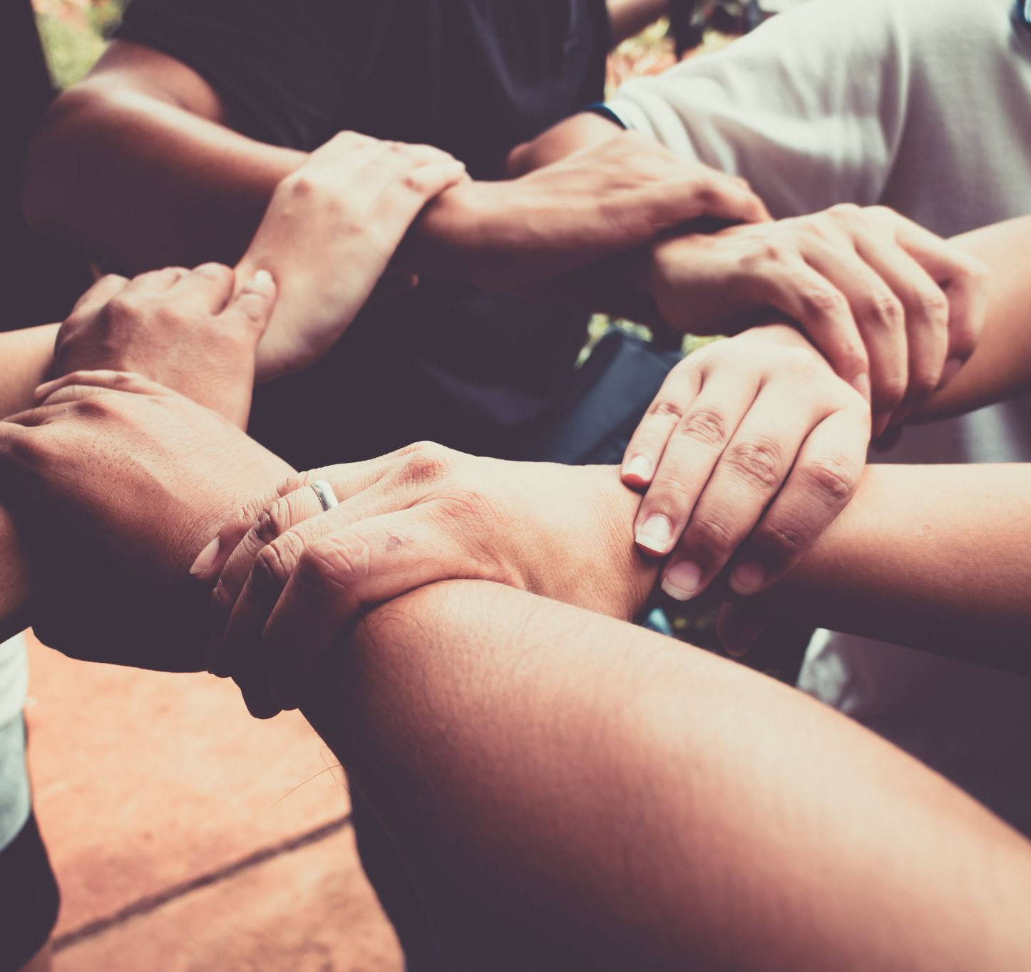
Key Takeaways
Final Reflections & Commitments
This is a practice, not a performance.
You will make mistakes. Learn from them with grace.
Your impact is immeasurable. Every small act of empathy has a powerful ripple effect.
Your Commitment: Take a moment to reflect on one action you will commit to this week to advance equity and empathy in your practice.
Notes:
To close, I want to leave you with a few key points. This work is a journey. It's not a destination where you become a 'perfect' educator. You will make mistakes, and that is okay. The goal is to learn from them and continue growing. Your impact is far greater than you can imagine. The small, empathetic actions you take in the classroom have a powerful ripple effect, creating a safer and more inclusive world for your students. To leave here with a concrete step forward, I want you to take a moment and reflect on one small, actionable commitment you can make this week. It could be as simple as learning a student's preferred name or as proactive as incorporating a new story into your next lesson. Thank you.

